Slide 1
Session Initiation Protocol (SIP)
Julien Jomier
Experimenting with mobile computing
Spring 2003

Slide 2

Outline
What is SIP?
SIP basics
SIP for mobility (Henning Schulzrinne)

Slide 3
What is SIP?
Signaling protocol used for establishing Sessions in an IP network
Relatively new : Feb. 1999
SIP is a Proposed Standard : RFC 2543
Telephony services across the internet
“Cheap” to “Serious” group of protocols

Slide 4
Sessions
Simple: Two-way telephone call
Collaborative multi-media conference
Voice enriched e-commerce
Instant Messaging with buddy list
IP Centrex
Notes:
Topic:IP Centrex
Author:Julien:Centrex is a set of specialized business solutions (primarily, but not exclusively, for voice service) + Adding voice over IP

Slide 5
SIP : a standard
Part of the IETF standards
Modeled upon other Internet protocols: SMTP, HTTP, etc…
Create, Modify and Terminate sessions between 1 or more users in an IP environment
Notes:
Topic:IETF
Author:Julien:Internet Engineering Task Force

Slide 6
SIP : a standard (cntd.)
Transport: RTP
Voice quality: RSVP, YESSIR
Directories: LDAP
Authentication: RADIUS, DIAMETER
Notes:
Find more about radius and diameter so I can talk about them

Slide 7
SIP functions
Name translation and User location
Feature negotiation
Call Participant Management
Call feature changes
Protocol Components

Slide 8
Protocol Components
SIP User Agent:
- User Agent Client (UAC)
- User Agent Server (UAS)
SIP Network Server:
Provides name resolution and user location.

Slide 9
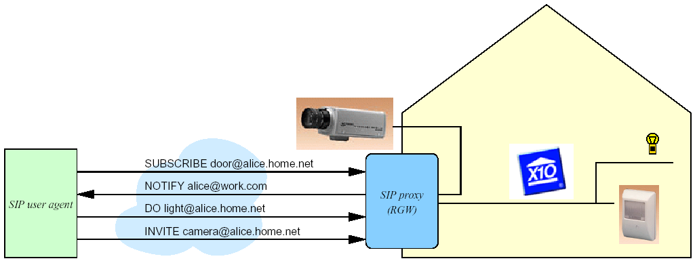
SIP for appliances

Slide 10
SIP for Mobile Applications
Henning Schulzrinne
VON Developer’s Conference 2000
Focus on Mobility
Notes:
Topic:VON
Author:Julien:Voice on the net

Slide 11
Mobility in an IP Environment
Terminal mobility: terminal moves between subnets
Personal mobility: different terminals, same address
Service mobility: keep same services while mobile
Notes:
Topic:
Author:Julien:

Slide 12
Terminal Mobility
Domain of IEEE 802.11, 3GPP, mobile IP,…
Main problems:
– handover performance
– handover failure due to lack of resources in new network
– authentication of redirection
Notes:
Topic: 3GPP
Author:Julien:The 3rd Generation Partnership Project (3GPP) is a collaboration agreement that was established in December 1998. The collaboration agreement brings together a number of telecommunications standards bodies which are known as “Organizational Partners”. The current Organizational Partners are ARIB, CWTS, ETSI, T1, TTA, and TTC.

Slide 13
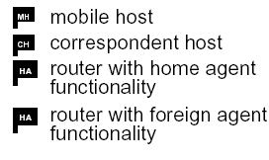
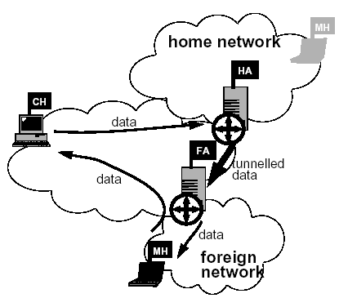
Terminal mobility – details
Move to new network => IP address changes (DHCP)
Mobile IP hides address changes
But: little deployment
Encapsulation overhead
May not work with IP address filtering
Notes:
Topic:
Author:Julien:

Slide 14
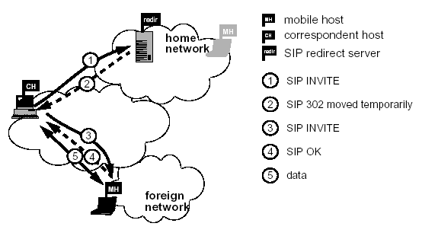
SIP terminal mobility: pre-call
MH acquires IP address via DHCP
Optional: MH finds SIP via multicast REGISTER
MH Updates home SIP server

Slide 15
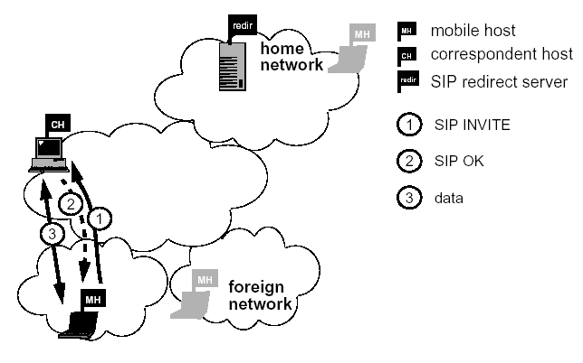
SIP terminal mobility: mid-call
MH->CH: new INVITE, with Contact and updated SDP
Re-registers with home registrar
Notes:
Topic: SDP
Author:Julien: Session Description Protocol

Slide 16
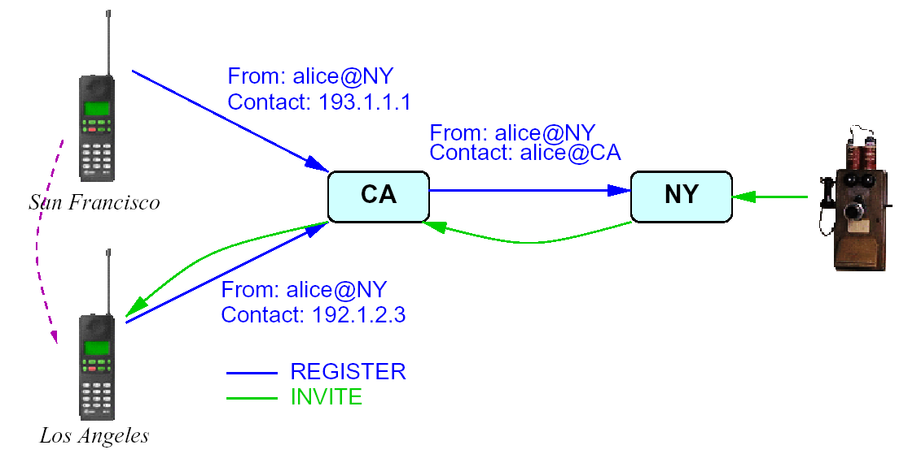
Multi-stage registration
Don’t want to bother home registrar with each move
Notes:
Topic:
Author:Julien:

Slide 17
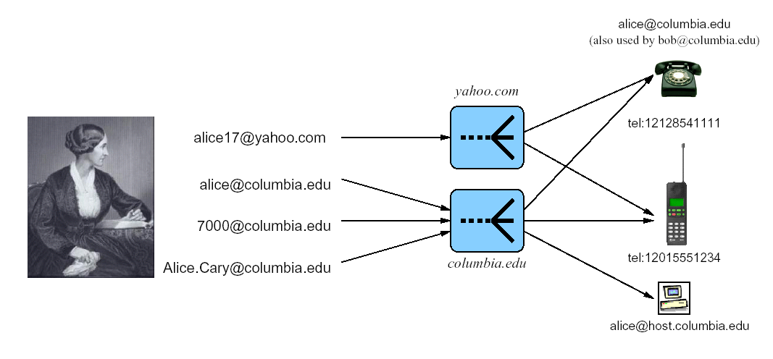
Personal mobility
Notes:
Topic:
Author:Julien:

Slide 18
Personal mobility
Switch between PDA, cell phone, PC, Ethernet phone, Internet appliance, . . .
Several “generic” addresses, one person/function, many terminals. e.g., tel:2129397042, hgs@cs.columbia.edu, schulzrinne@yahoo.com or support@acme.com
SIP is designed for that – proxying and redirection does translation
Notes:
Topic:
Author:Julien:

Slide 19
Personal mobility
BUT Need mapping mechanisms to recognize registrations as belonging to the same person.
some possible solutions:
– dip into LDAP personnel database or /etc/passwd to match phone number and variations of name (J.Doe, John.Doe, Doe)
– need dialing plan to recognize 7042@cs.columbia.edu and tel:2129397042 as same
Notes:
Topic:
Author:Julien:

Slide 20
Service mobility
Examples:
Speed dial & Address book
Media preferences
Special feature buttons (voice mail, do-not-disturb)
Incoming call handling instructions
Buddy lists
=> independent of terminal (including pay phone!), across providers
Notes:
Topic:
Author:Julien:

Slide 21
Service mobility
REGISTER can retrieve configuration information (e.g., speed dial settings, distinctive ringing or voice mail settings)
But needs to be device-independent
Most such services (e.g., voicemail forwarding, call filtering) should remain on server(s)
Notes:
Topic:
Author:Julien:

Slide 22
Service mobility
Separate issue: how does the payphone (or colleague’s phone) recognize you?
PDA (IR)
i-button
fingerprint
speech recognition, . . .
One device, but changing set of owners!
Notes:
Topic:
Author:Julien:

Slide 23
Service mobility – call handling
Need uniform basic service description model => Call Processing Language (CPL)
CPL = XML-based flow graph for inbound & outbound calls
CPL for local call handling
Update CPL from terminal: add telemarketer to block list
Harder: synchronize CPL changes across multiple providers
One possibility: REGISTER updates information, but device needs to know that it has multiple identities
Merging of call logs
Notes:
Topic:
Author:Julien:

Slide 24
SIP and mobility: issues
Doesn’t work for TCP applications: solutions:
- punt: “don’t walk while telnet’ing”
- Application-layer awareness: restart web, email, ftp transfer
- NAT-style boxes controlled by SIP (see Telcordia ITSUMO project)
But: works nicely for “vertical handoff” between different technologies - e.g., transfer call from mobile handset to office videophone when arriving at work
Notes:
Topic:
Author:Julien:

Slide 25
Conclusion
Mobility is more than just wireless handsets
Terminal, personal and service mobility
SIP enables all three, but likely to be hybrid solutions
Notes:
Topic:
Author:Julien:

Slide 26
Links
http://www.cs.columbia.edu/sip/
http://www.sipcenter.com/
http://www.cs.columbia.edu/~hgs/rtp
http://www.cs.columbia.edu/IRT

